Slide 1
Spaceship
Titanic
By Benjamin Burns
Maria Ibarra Prado
Joshua Feinberg
Gina Leonardi
and David Akiyama
June 5, 2912
Notes:
David

Slide 2
The Spaceship Titanic was an ill-fated interstellar passenger liner which launched one earth month prior.
With almost 13,000 passengers on board, the vessel set out on its maiden voyage transporting interstellar refugees from our solar system to three newly habitable exoplanets orbiting nearby stars.
While rounding Alpha Centauri en route to its first destination—the torrid 55 Cancri E—the unwary Spaceship Titanic collided with a spacetime anomaly hidden within a dust cloud.
Sadly, it met a similar fate as its namesake from 1000 earth years before. Though the ship stayed intact, almost half of our passengers were transported to an alternate dimension.
To help the rescue crews retrieve the lost passengers, we are tasked with predicting which passengers were transported by the anomaly using records recovered from the spaceship’s damaged logs.
Notes:
Joshua

Slide 3
What We Know
The data that was recovered from the damaged logs includes the following…
PassengerId - A unique Id for each passenger
HomePlanet - The planet the passenger departed from
CryoSleep - Indicates whether the passenger elected to be put into suspended animation for the duration of the voyage. Passengers in cryosleep are confined to their cabins.
Cabin - The cabin number where the passenger is staying. Takes the form deck/num/side, where side can be either P for Port or S for Starboard.
Destination - The planet the passenger will be debarking to.
Age - The age of the passenger.
VIP - Whether the passenger has paid for special VIP service during the voyage.
Room Service, Food Court, Shopping Mall, Spa, VR Deck - Amount the passenger has billed at each of the Spaceship Titanic's many luxury amenities.
Name - The first and last names of the passenger.
Transported - Whether the passenger was transported to another dimension in the accident or not.
Notes:
David

Slide 4
SQL Cloud Database, BigQuery
After recovering the black box from the wrecked logs of the ship, the data was uploaded onto Galactic Republic’s servers for SPACE FEMA to analyze.
To share and access files across the Empire, we combined the data into a single dataset, and then normalized it into 3 tables. PassengerId was used as a Primary Key for all tables as it the only column with no duplicates and no null values.
We combined, normalized, and adjusted the data types in Python, exported the files in the ancient CSV format (for security), and then created a cloud database using BigQuery in Google Cloud (which surprisingly still exists). The team members can access the database with a JSON key file.
This key controls access to the database to keep it secure from any possible interstellar threats.
Notes:
Joshua

Slide 5
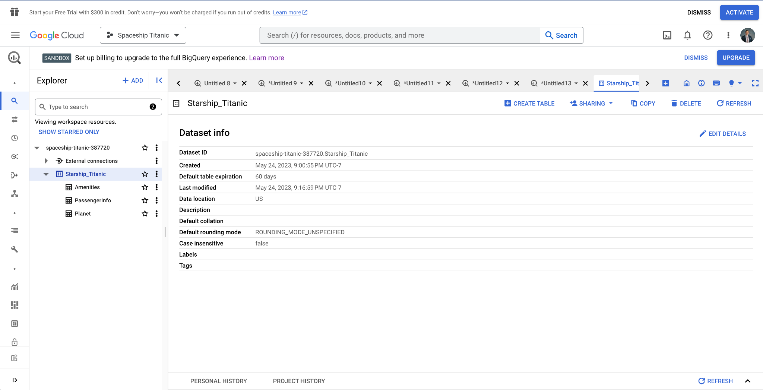
Our Database

Slide 6
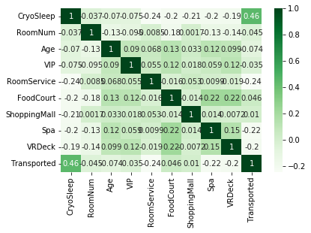
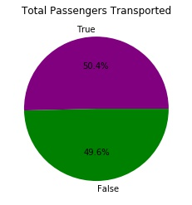
Total Transported
We have passenger records for 12,970 passengers and have a confirmed the location of 8,693.
Of these - 50.4% were transported.
Notes:
Gina
Total Passengers: 50.4% of passengers with known whereabouts were transported. We started with further exploratory analysis to learn more about why that may have happened.
This heat map shows the any correlation between features that were available to us through the passenger data. The darker the green color, the more correlation.
We are specifically interested here in the correlation with the “transported” column.
Demographic categories: nearly no correlation for age, vip status, or room number.
Spending vs cabin number: spending a lot of money had a slightly higher correlation than others
possibly meaning that if passengers were spending they spent less time in their cabin which was a more secure space, and thus were more likely to be on a ship deck at the time of the incident. One question here is room service, which has a small correlation but is higher than others.
Highest Correlation: .45 correlation: Transported has a moderate positive correlation with CryoSleep of .45, indicating that those who were in CryoSleep tend to have a higher likelihood of being transported.

Slide 7
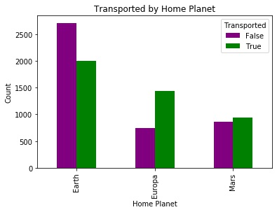
By Home Planet
Passengers are from home planets Mars, Europa, and Earth.
Home Planet correlation with being transported:
Earth: -.11
Europa: .09
Mars: .03
Notes:
Gina
On this slide we’re looking at any relationship between the passengers home planet and whether or not they were transported.
This is demographic information showing the passengers permanent residence. The most passengers were from Earth.
Very small correlation with being transported - nearly nonexistent.
Interesting to note that Earth is the only home planet where “False” is a higher count than “True” . Small negative correlation (-.11)
Mars is fairly even split (.03 correlation)
Europa had more transported than not from the known passengers. (.09 correlation)

Slide 8
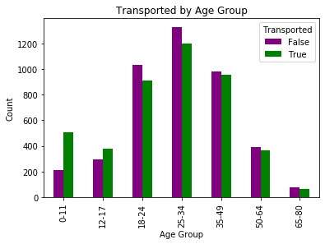
By Age
Slight negative correlation (-.07). Age does not appear to have a significant correlation with being transported.
Notes:
David

Slide 9
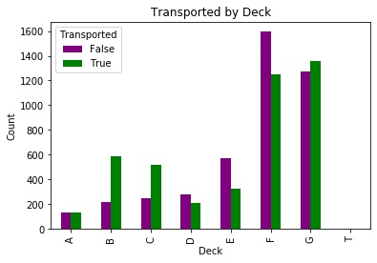
By Deck
No strong correlation, though it varies by deck. The most significant correlation is Deck B at .14, indicating these folks were slightly more likely to have been transported.
Number of passengers on each deck:
F 2847 G 2626 E 897 B 803 C 764 D 485 A 266 T 5
Notes:
David

Slide 10
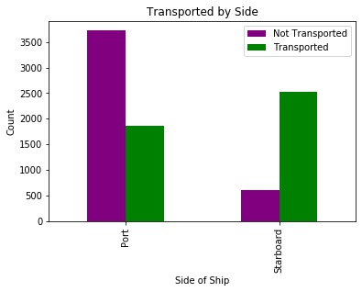
By Side
Side of the ship (port and starboard). Side_P has a slight negative correlation (-.1) and Side_S has the opposite positive correlation (.1). This correlation is relatively weak.
Notes:
Maria

Slide 11
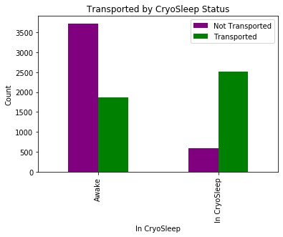
By Cryo Sleep
Transported has a moderate positive correlation with CryoSleep of .46, indicating that those who were in cryosleep tend to have a higher likelihood of being transported.
Notes:
Maria

Slide 12
Data Cleaning
For machine learning to be properly used, the data had to first be prepped.
Check for redundancy
Every column only contains one value
Eliminate unnecessary information
Correct data types
Correct typos
Dummify categorical variables
Replace or remove missing values
Notes:
Black box saved from the wreck
We have been tasked to determining how to predict transported passengers in the future to minimize loss of passengers, crew, and profit

Slide 13
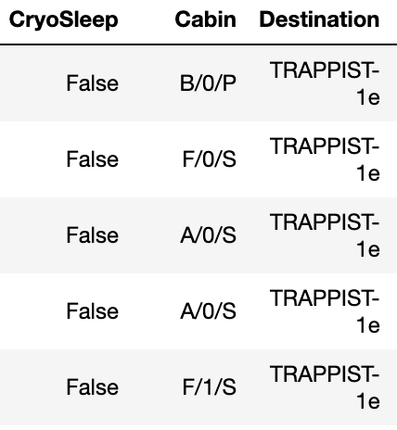
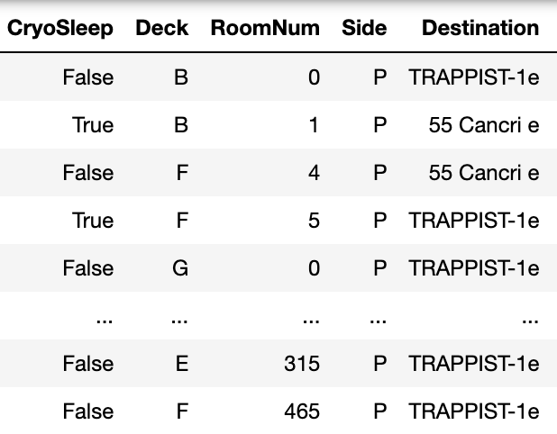
One Value per Column
Notes:
Ben

Slide 14
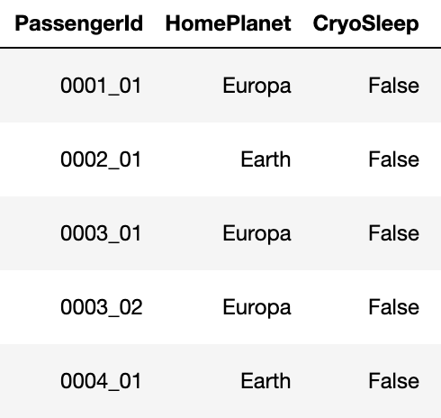
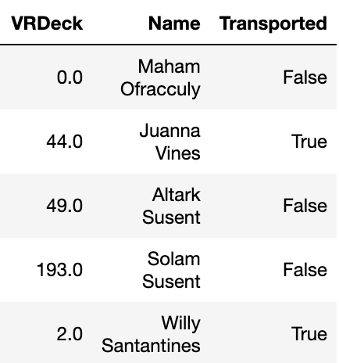
Unnecessary Columns
Notes:
Ben

Slide 15
Data Imputation
Several forms data imputation were attempted to retain as much data as possible.
Numeric values were imputed with column means.
Categorical values were imputed with the next observed value.
These strategies of data imputation proved counterproductive and resulted in lower accuracy ratings from our models.
Using k-neighbors to replace values from similar rows did show a very slight improvement in our models prediction ability
Finding more successful methods of data imputation could still prove valuable.
Notes:
Ben

Slide 16
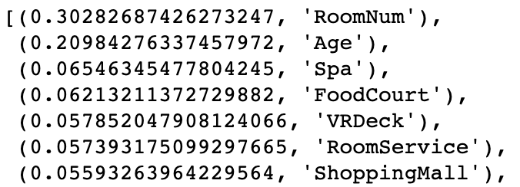
Prediction Models
Our team tried a variety of prediction models such as:
Logistic Regression - 79%
K-Nearest Neighbors - 76%
Random Forest - 81%
Neural Networks - 82%
While every model was able to achieve reasonably good accuracy scores of over 75%, our highest performer was using neural networks via TensorFlow for an accuracy of 82%.
Notes:
Logistic Regression was tried first because the data satisfied the following assumptions, which usually are good fit for logistic regression:
It was simple and met the requirements
•The predicted outcome is strictly binary. (Transported vs. Not transported).
•The factors, that influence the outcome are independent of each other. In the model we dropped the dummy variables that were opposite to each other to avoid In other multicollinearity among the independent variables.
•The independent variables can be linearly related to the log odds.
Random Forest was used because it allows the computation of feature importance

Slide 17
Neural Networks via TensorFlow
Using Google Colab, we trained neural network models using Tensorflow.
We adjusted and experimented with many different hyper(space)parameters including adjusting:
hidden layers
neurons per hidden layer
activation functions
various optimizers
various numbers of epochs
Notes:
Joshua

Slide 18
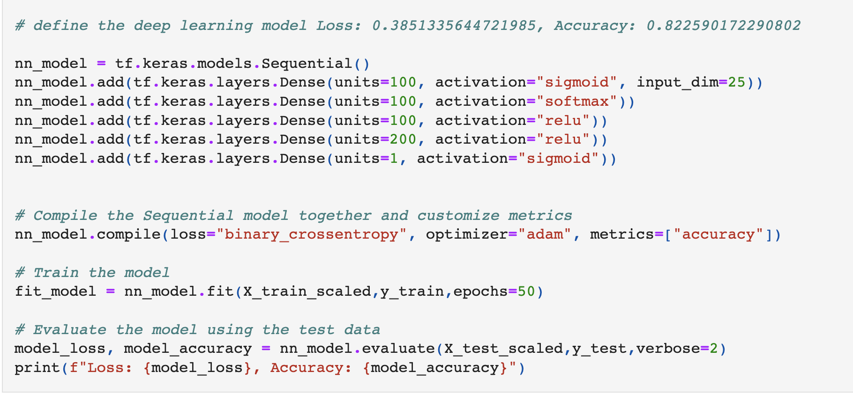
Final Product
This is the model that yielded the best results to predict whether or not a passenger was transported, with an accuracy of 82.26% and a loss of 38.51%.
Notes:
Joshua

Slide 19
Conclusion
In order to maintain our current energy efficient route through the dust cloud on future journeys while also maintaining highest possible revenue from every voyage, the following policies will be enacted.
Using Neural Network model predictions, the reservations of VIP customers will be altered to ensure the relative safety of our highest paying consumers. If the model predicts a VIP customer would be lost while traversing the space/time anomaly, they will be alerted and moved to a safer location before entering that region of space.
Cryo sleep chambers will be moved to a safer portion of the ship.
A second black box will be installed so further research can be done on what factors influence the transportation of passengers.
Notes:
Gina

